Slide 1
Protection and Security

Slide 2
Why?
Implementation to prevent interference with the use of files, both logical and physical.
Protection: refers to the actual mechanism implementation enforce a specified policy.
Preventing the unauthorized access and to avoid any unauthentic changes and manipulations
Security: Using security we implement the policies defined under protection by using various methods.
It aims to prevent intentional misuses of a system while protection aims to prevent either accidental or intentional misuse.

Slide 3
Goals of protection
Obviously to prevent malicious misuse of the system by users or programs.
To ensure that each shared resource is used only in accordance with system policies, which may be set either by system designers or by system administrators.
To ensure that errant programs cause the minimal amount of damage possible.

Slide 4
Goals of a secure system
Confidentiality
Integrity
Availability

Slide 5
Principle of protection
Principle of Least Privilege
dictates that programs, users, and systems be given just enough privileges to perform their tasks.

Slide 6
Domain of Protection
A computer can be viewed as a collection of processes and objects ( both HW & SW ).
The need to know principle states that a process should only have access to those objects it needs to accomplish its task, and furthermore only in the modes for which it needs access and only during the time frame when it needs access.
The modes available for a particular object may depend upon its type.

Slide 7
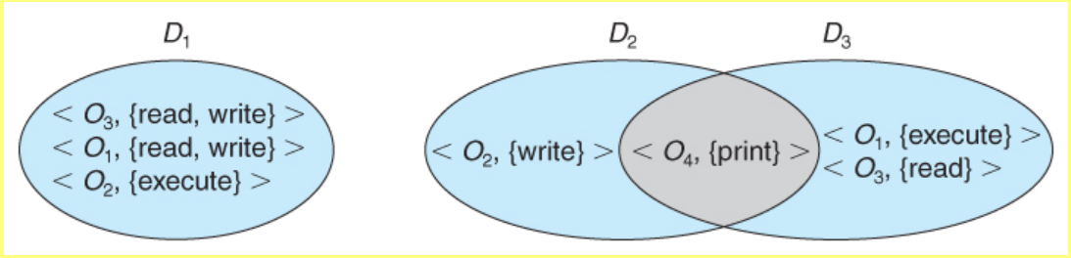
Domain structure

Slide 8
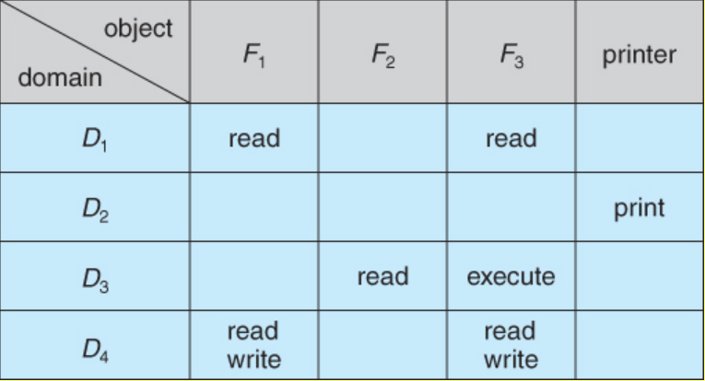
Access Matrix
The model of protection that we have been discussing can be viewed as an access matrix, in which columns represent different system resources and rows represent different protection domains. Entries within the matrix indicate what access that domain has to that resource.

Slide 9
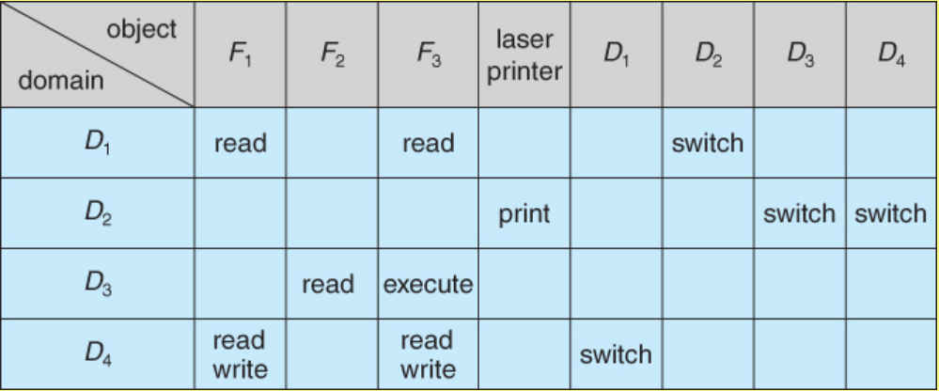

Slide 10
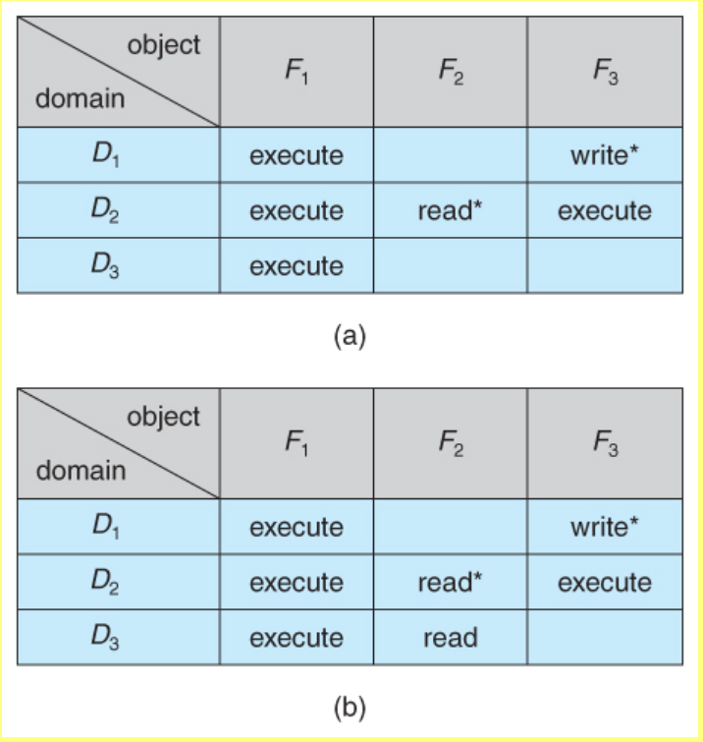

Slide 11
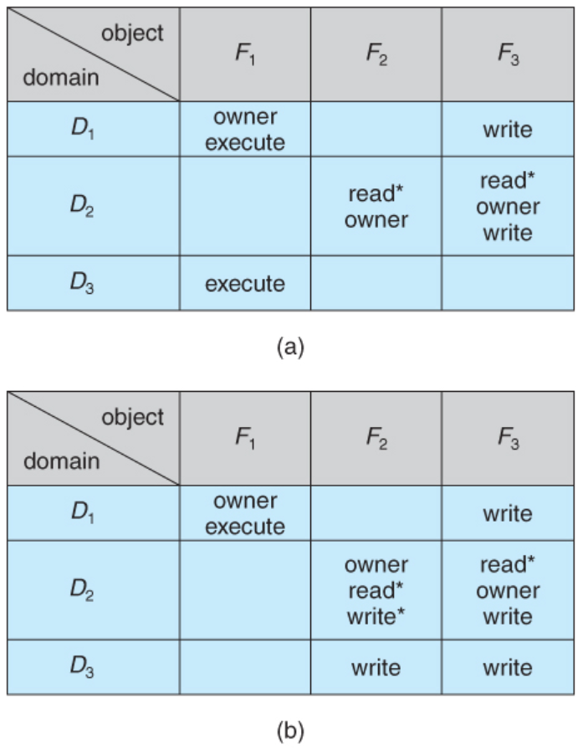

Slide 12
Implementation of access matrix
Global Table
Access list for objects
Capability list for domains
Lock and key mechanism

